Slide 1
CAPSTONE PROJECT Bhushan mali

Slide 2
Agenda
Project Overview
Approach and Methodology
Key Findings and Results Business Impact and Recommendations
Limitations and Future Work Conclusion

Slide 3

Project Overview
Business Problem
In the highly competitive telecom industry, customer churn is a significant challenge, with an annual churn rate of 15-25%. Retaining highly profitable customers is crucial as it costs 5-10 times more to acquire a new customer than to retain an existing one. The objective of this project is to analyze customer-level data of a leading telecom firm, build predictive models to identify customers at high risk of churn, and identify the main indicators of churn.
Project Objectives
Predict churn for high-value customers using data from the first three months (June, July, August) to identify customers at risk of churning in the fourth month (September).
Identify important variables that are strong predictors of churn, providing insights into why customers choose to switch to other networks.
Recommend strategies to manage customer churn based on the analysis and observations.

Slide 4
Approach & Methodology
Data Preparation
Filter High-Value Customers: Define high-value customers as those who have recharged with an amount greater than or equal to the 70th percentile of the average recharge amount in the first two months (June and July).
Tag Churners: Identify churners based on the fourth month (September) data, considering customers who have not made any calls (incoming or outgoing) and have not used mobile internet.
Remove Churn Phase Data: After tagging churners, remove all attributes corresponding to the churn phase (September) from the dataset.
Modeling
Predictive Model: Build a predictive model to identify high-value customers at risk of churn in the near future (September). Handle class imbalance using appropriate techniques.
Logistic Regression Model: Develop a logistic regression model to identify important predictor attributes that help understand the indicators of churn. Handle multicollinearity if present.
Feature Importance Visualization: Display the important predictors visually using plots, summary tables, or any other appropriate method to convey their significance.

Slide 5
FINDINGS & SUGGESTIONS
Try to offer the better service for the churn customers, see how much this impact before and later .Some may use your service better move them to your active customers.
Take the feedback and suggestions within period of time and improve it, strive for better communication.
When you are taking the any change in plans of your business just predict the positive and negative share of that plan. If it is negative prepare the solution before so You can handy easily.

Slide 6
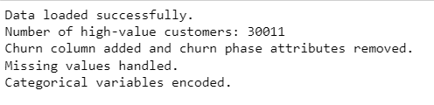
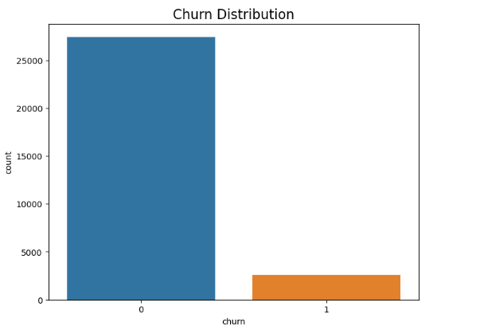
Analysis

Slide 7
Recommendations
Focus on improving service quality and customer experience in circles with high churn rates.
Offer personalized plans and discounts to customers with low recharge amounts to retain them.
Monitor and analyze customer usage patterns to identify potential churners.
Improve the factors identified as important indicators of churn, such as network quality, customer support, and pricing plans.
Implement targeted retention strategies for high-value customers based on their usage patterns and preferences.

Slide 8
THANK YOU
Bhushan Mali

